Slide 1


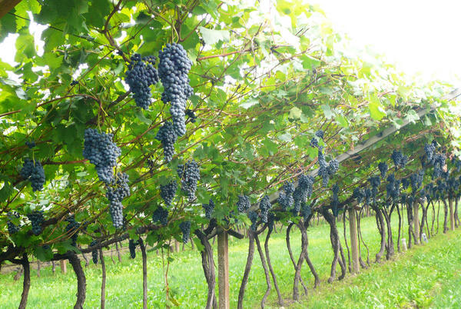


“INTEGRAPE”
Chair: Mario Pezzotti

Slide 2
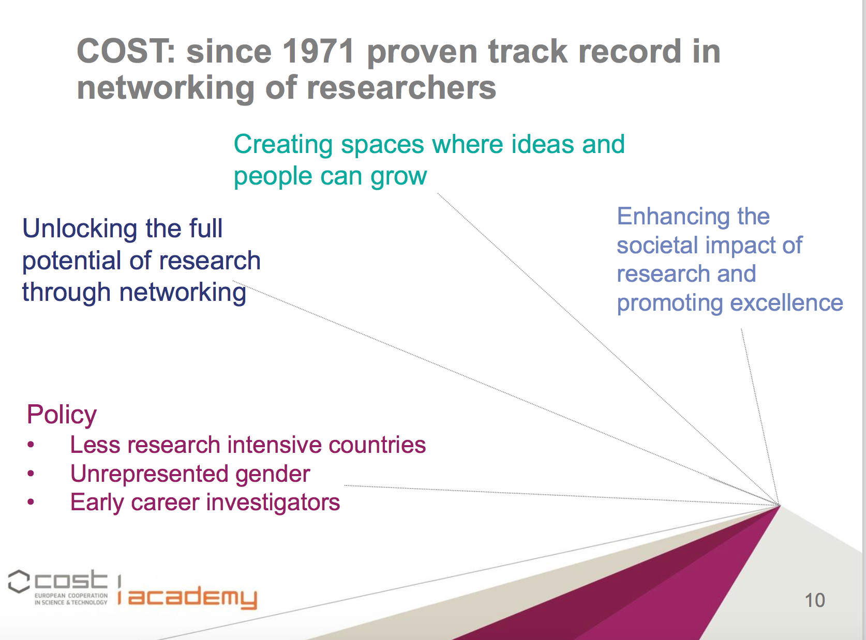

Slide 3
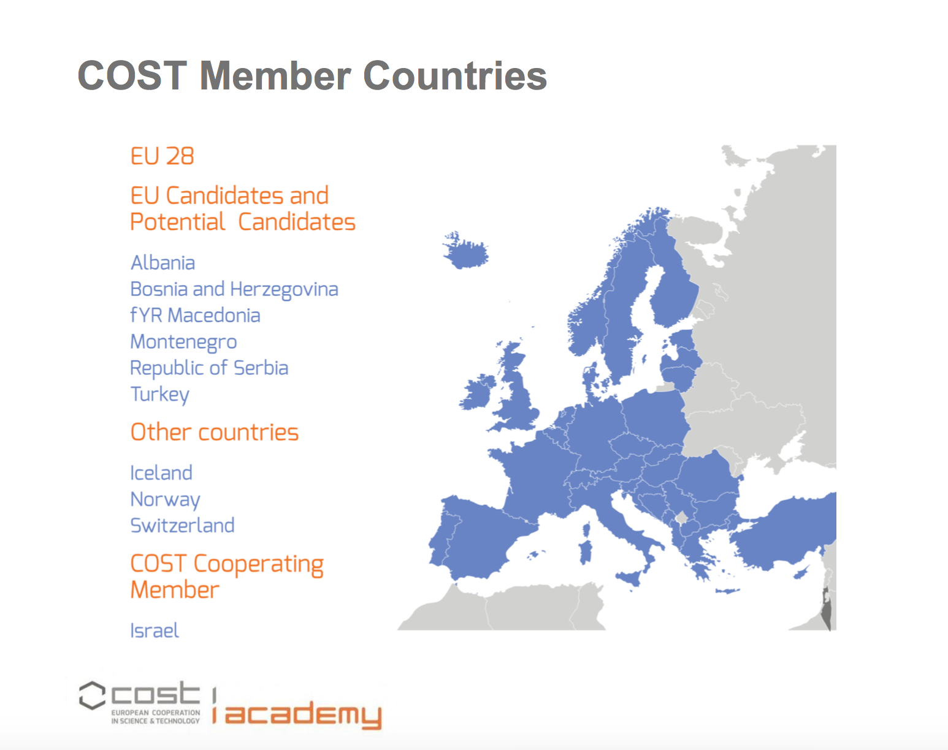

Slide 4
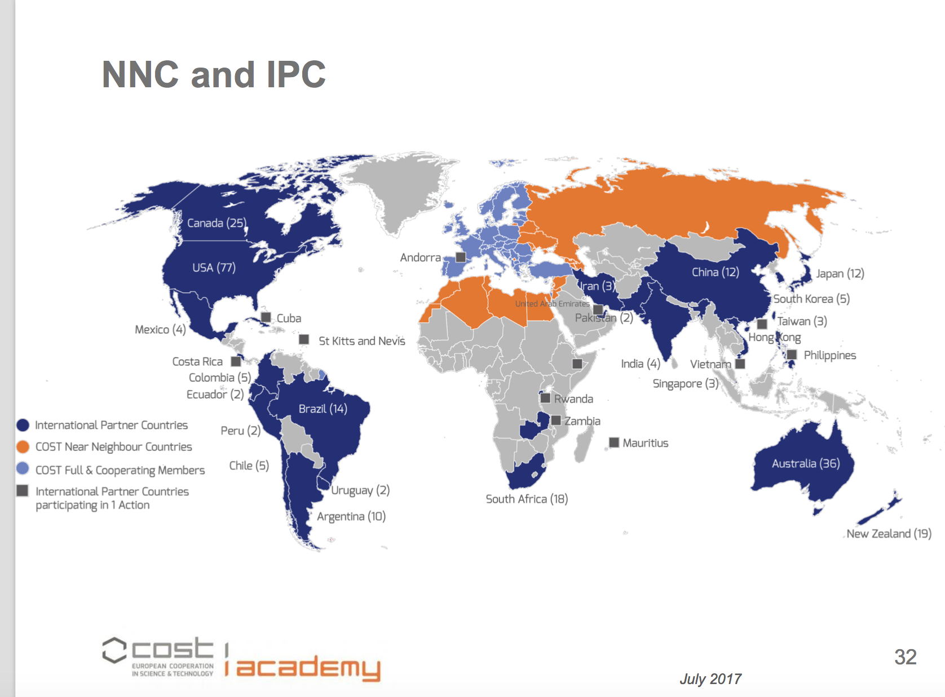

Slide 5
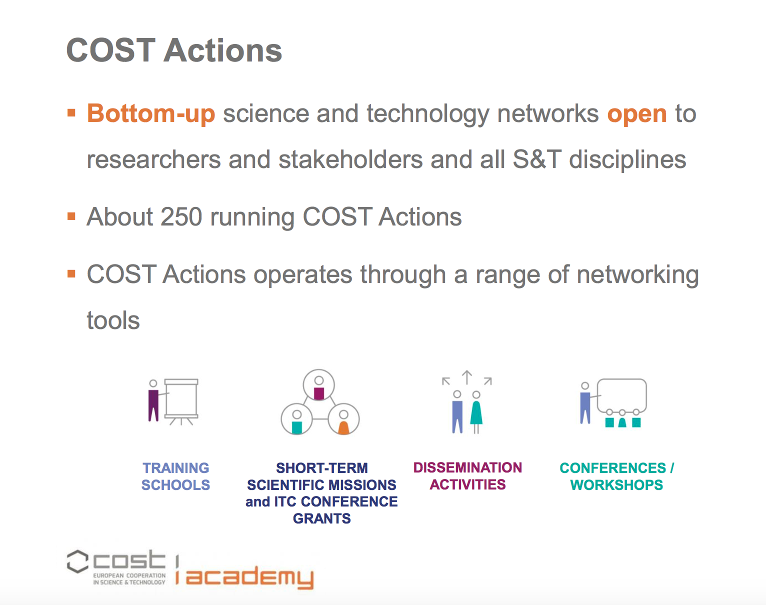

Slide 6


Slide 7
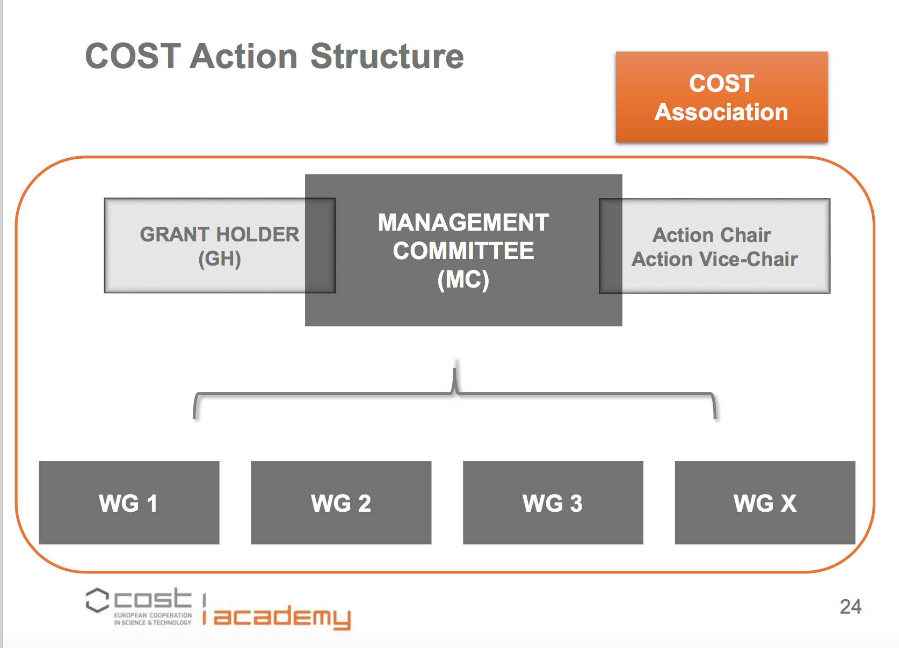

Slide 8
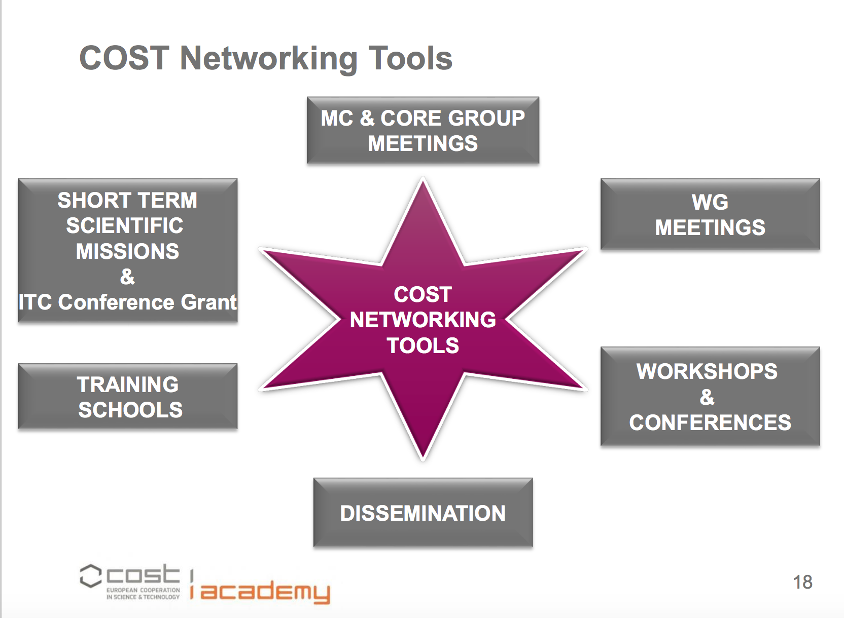

Slide 10
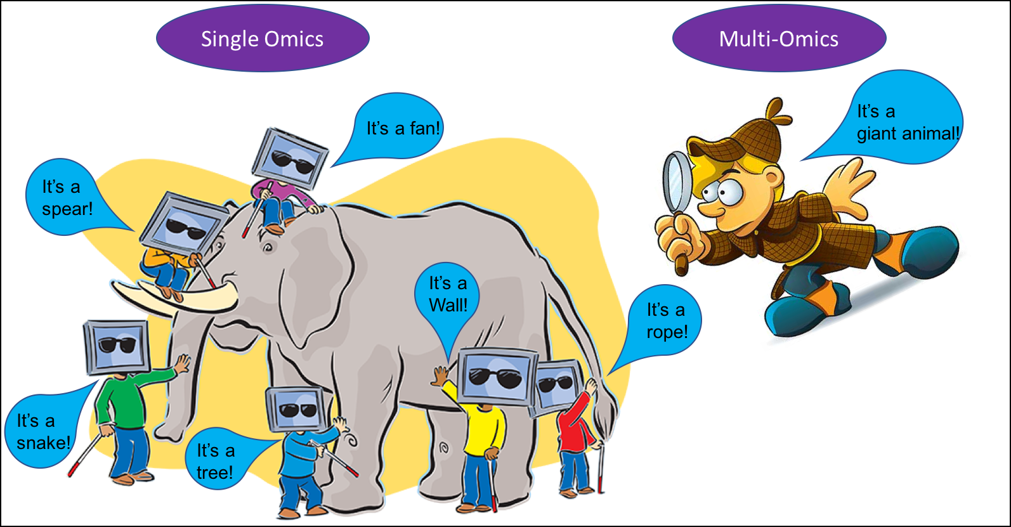
Different -omics sciences describe many levels of biomolecular organization – but if used in isolation may give misleading inferences about the system !

Slide 11
Grapevine research focuses on interactions between the genotype, phenotype and environment, and information must be integrated from heterogeneous datasets including ampelography, environmental biology, genetics, genomics, epigenomics, transcriptomics, proteomics and metabolomics.
The data are currently dispersed and difficult to Access, hindering meta-analysis (the Re-use of grapevine data beyond the original experiments).
No institution working in the field of grapevine research has yet taken on the mission to improve data integration and Interoperability at the global level, although the grapevine research community is continuously producing large datasets.
The concepts described will support stakeholders by developing innovative strategies to integrate grapevine data from existing resources and new experiments in a cost-effective manner, as well as making interoperable grapevine datasets and tools Findable in a secure and standardised format.

Slide 12
Challenge of the CA 17111
Establish an open, international, and representative network that integrates data from existing resources in a cost-effective manner, as well as making interoperable grapevine dataset and tools available in a secure and standardized format

Slide 13
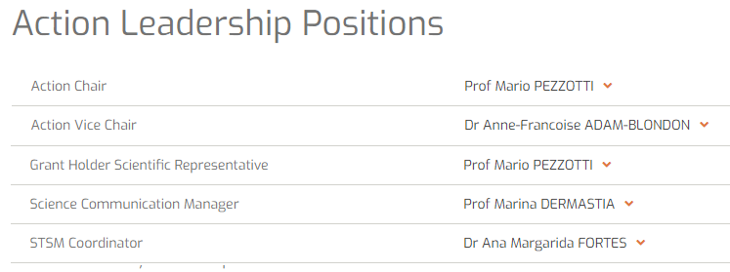
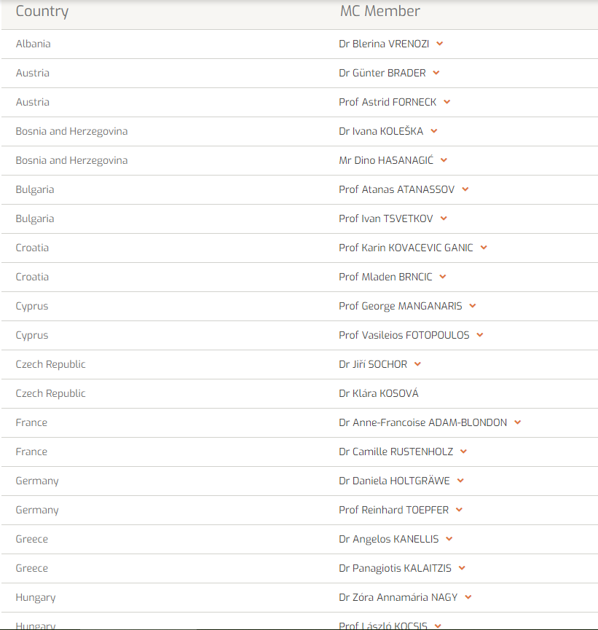
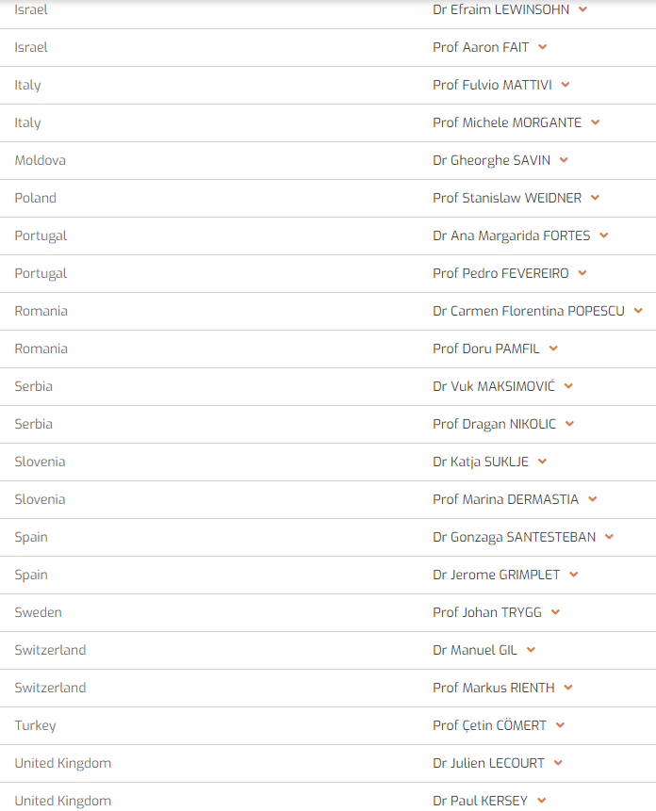

Slide 14
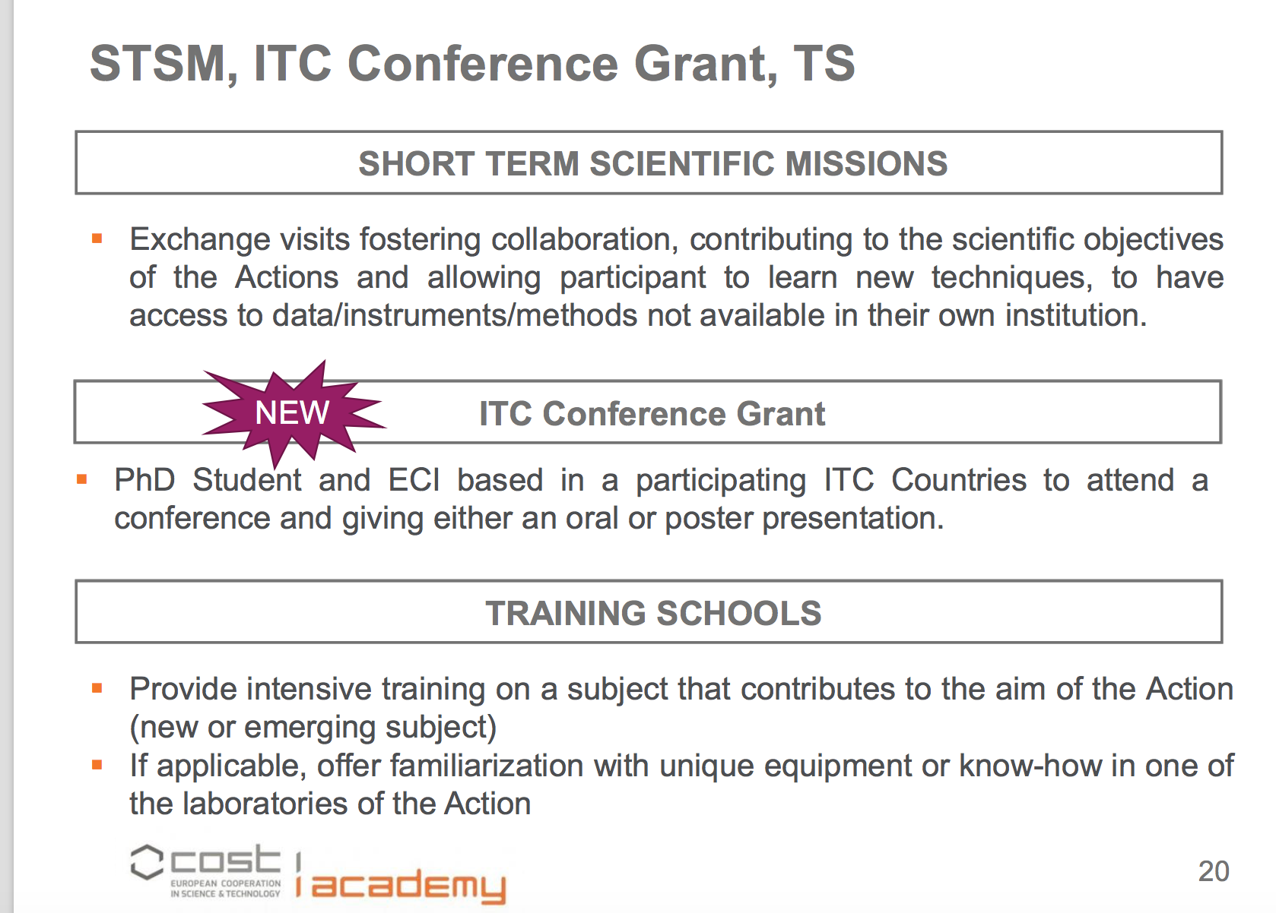

Slide 15
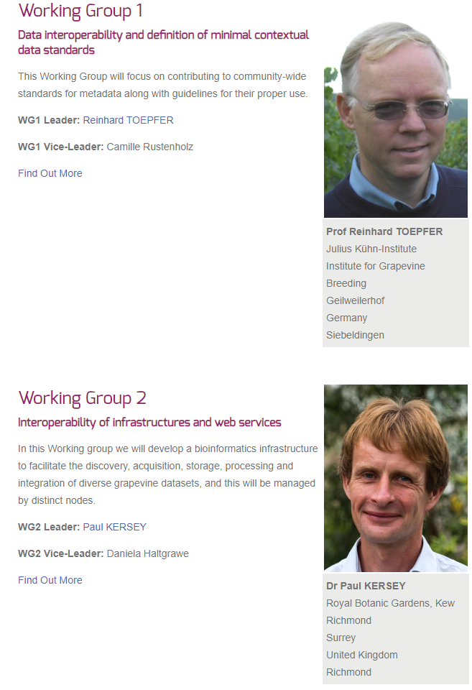
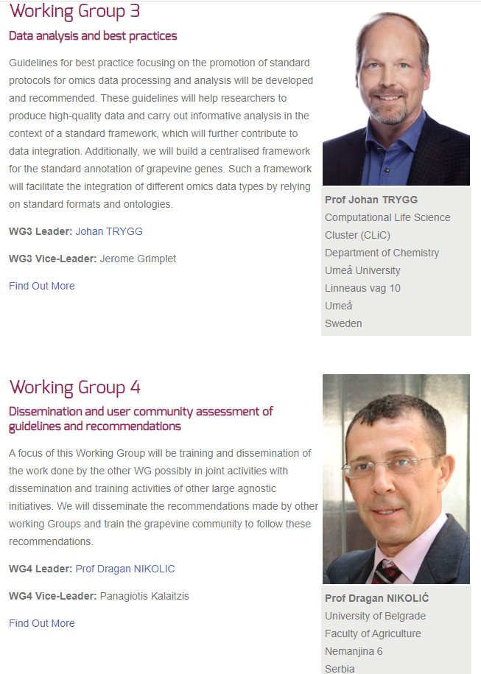

Slide 16
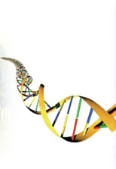
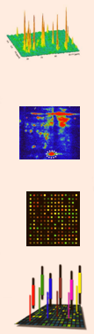
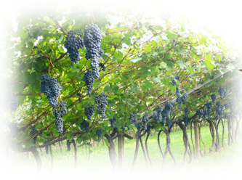
Pilot Projects
Genome data
C. Rustenholtz
metadata for genome submission to ENA
Omics data
J. Grimplet
requirements for Omics submissions
Phenotyping data
E. Duchene
standardisation of the organs naming, development stages, Vitis ontology

Slide 17
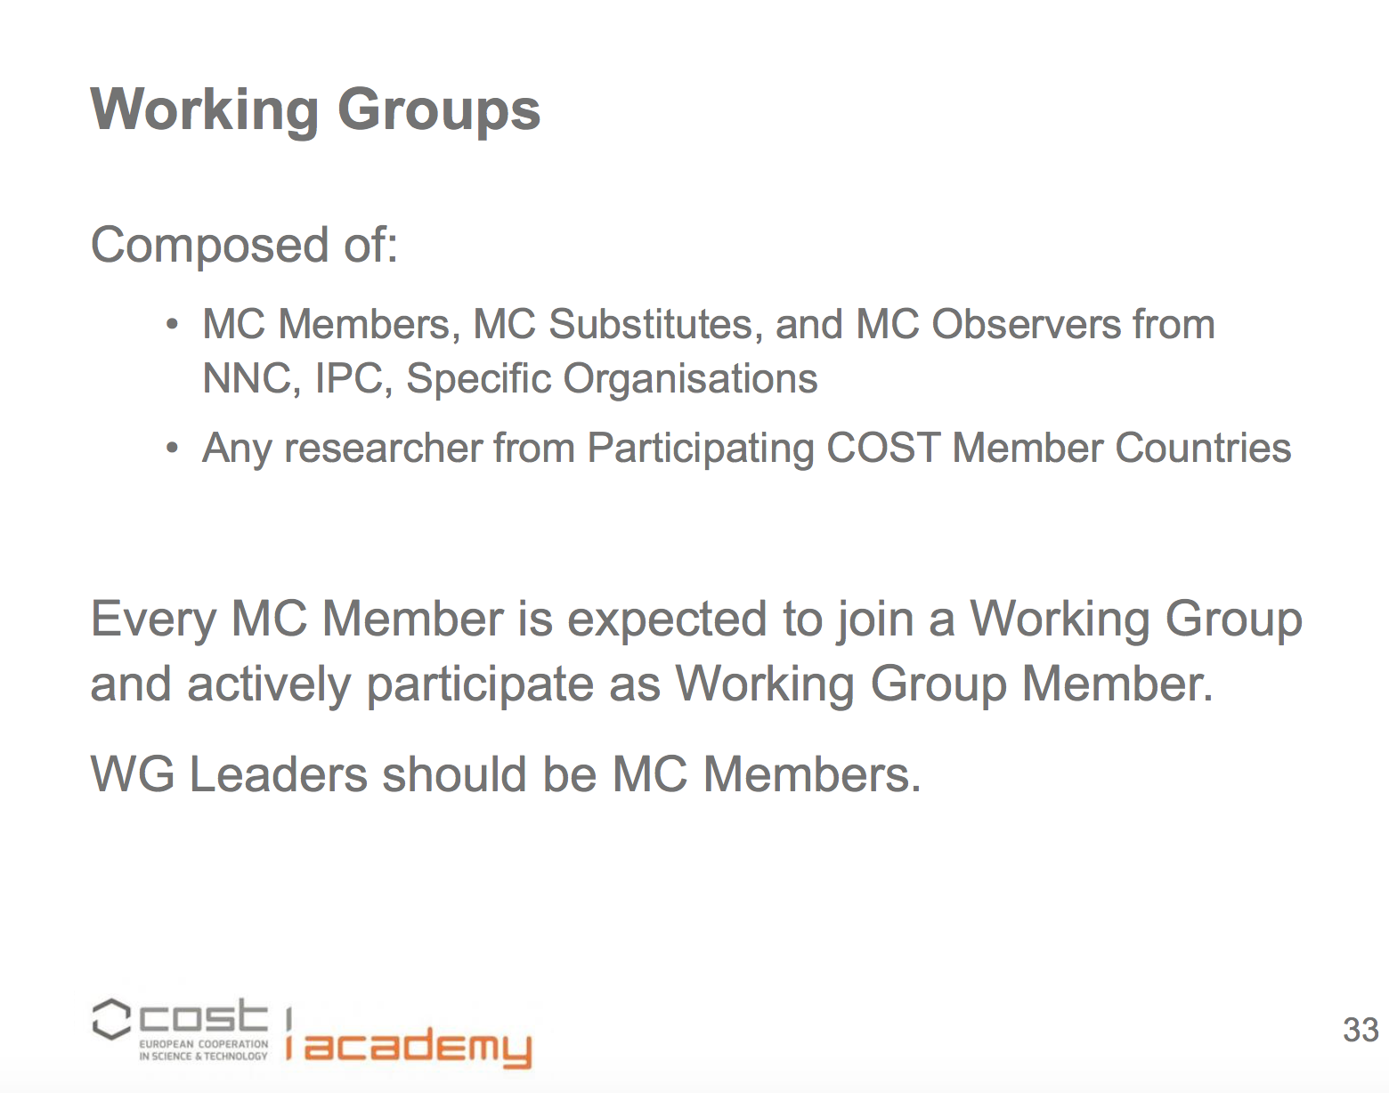

Slide 18
Inclusiveness Target Countries (ITC)
Bosnia and Herzegovina, Bulgaria, Croatia, Cyprus, Czech Republic, Estonia, fYR Macedonia, Hungary, Latvia, Lithuania, Luxembourg, Malta, Montenegro, Poland, Portugal, Romania, Serbia, Slovakia, Slovenia, Turkey

Slide 19
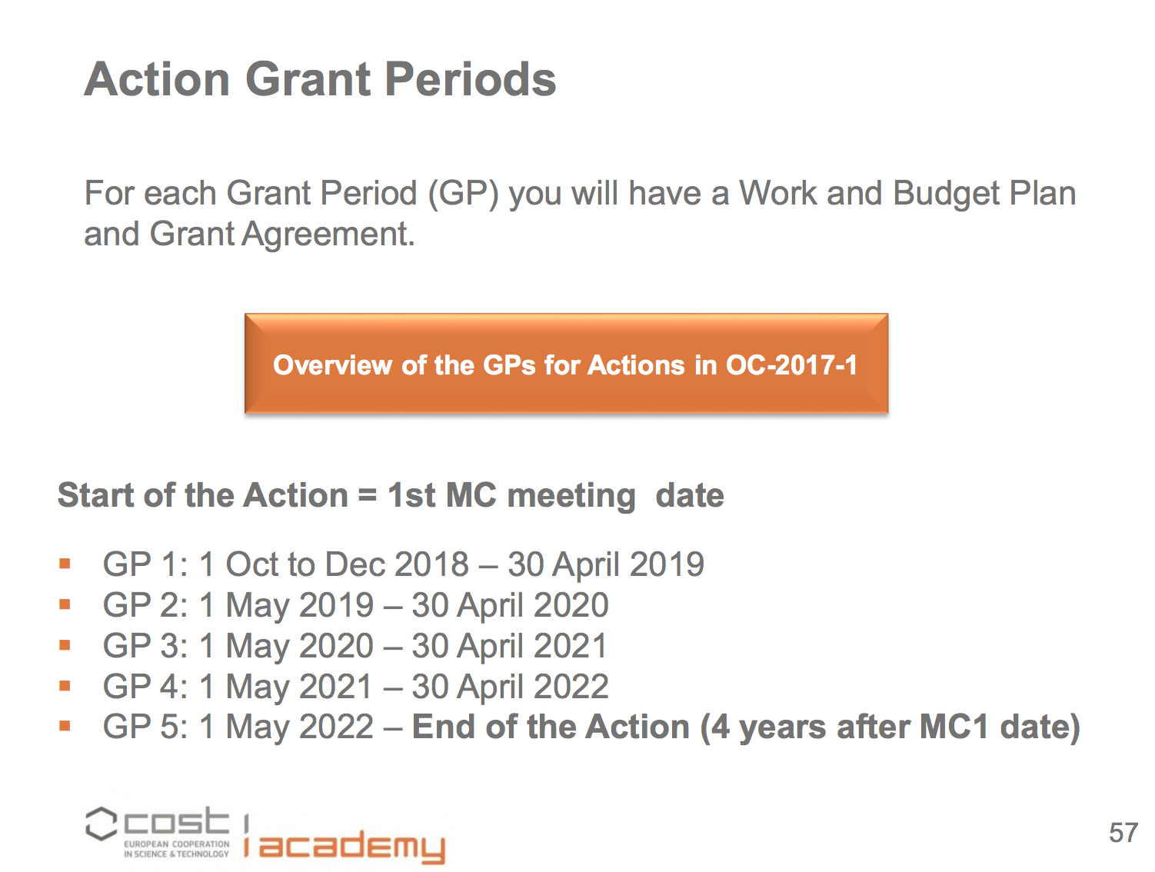

Slide 20
PLEASE JOIN THE CA 17111

